Slide 1
Scale & Affine Invariant Interest Point Detectors
K Mikolajczyk, C Schmid
International journal of computer vision, 2004
2190400726 贺识丹

Slide 2
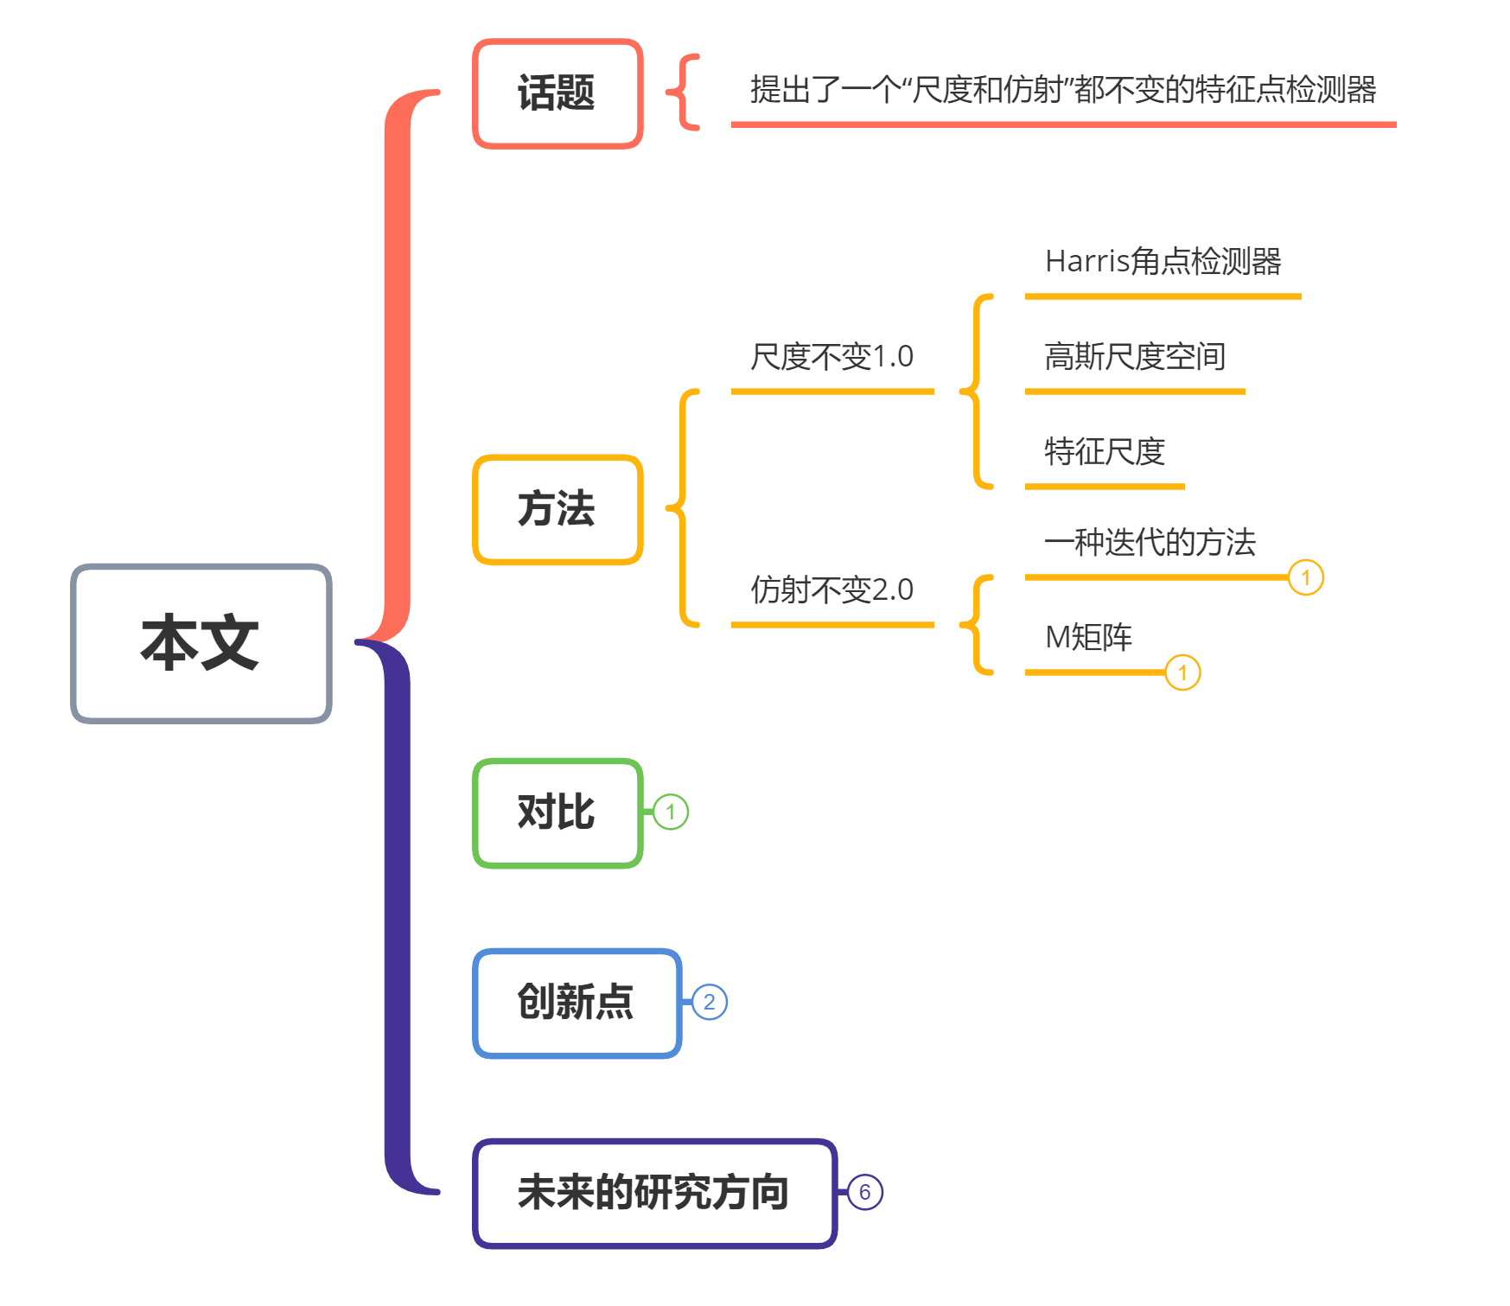

Slide 3
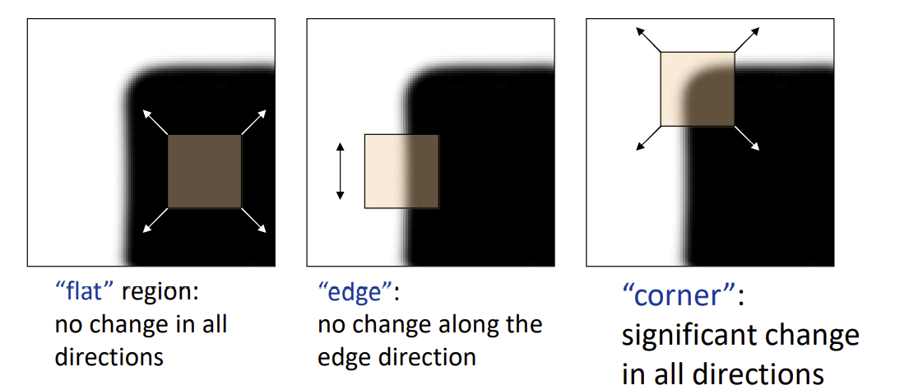
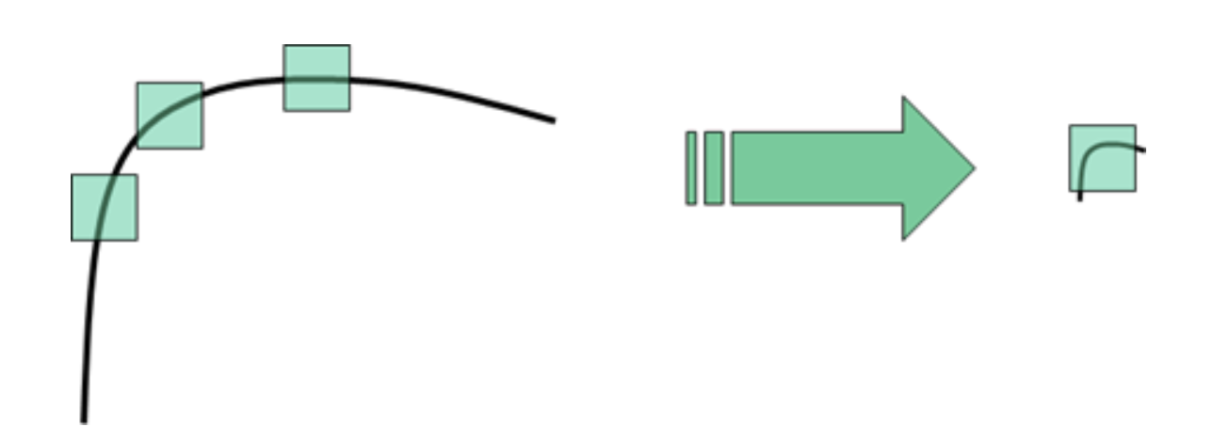
Harris corner measure

Slide 4
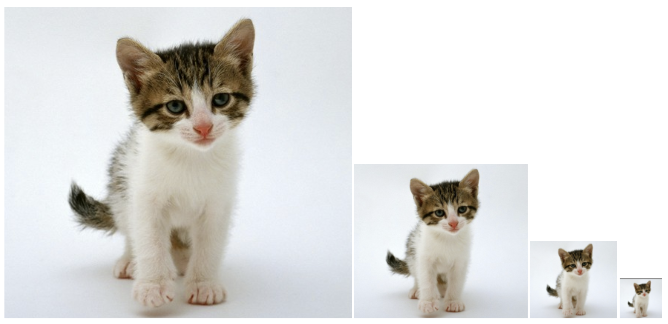
Gaussian scale-space
A Gaussian scale space representation of an image is the set of images that result from convolving a Gaussian kernel of various sizes with the original image.

Slide 5
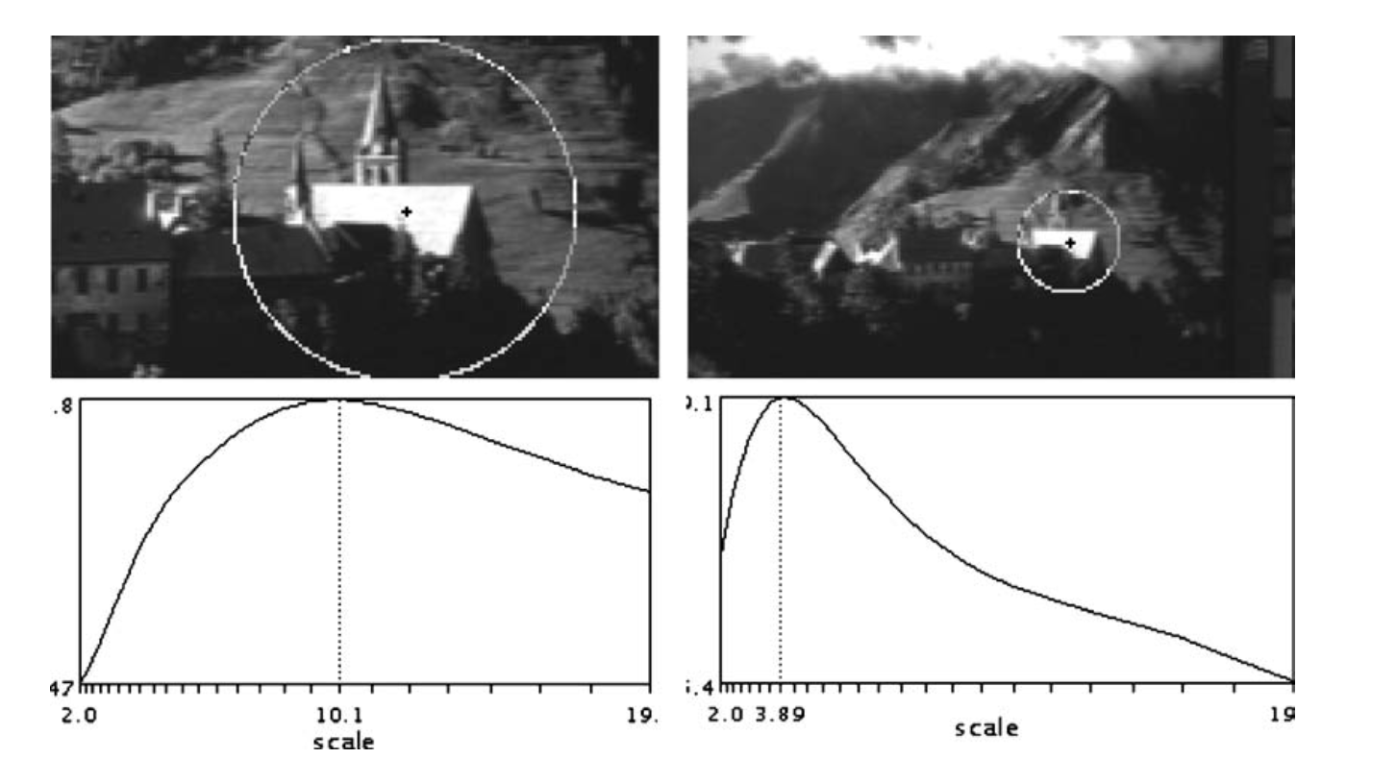
Characteristic scale identification： LoG response

Slide 6
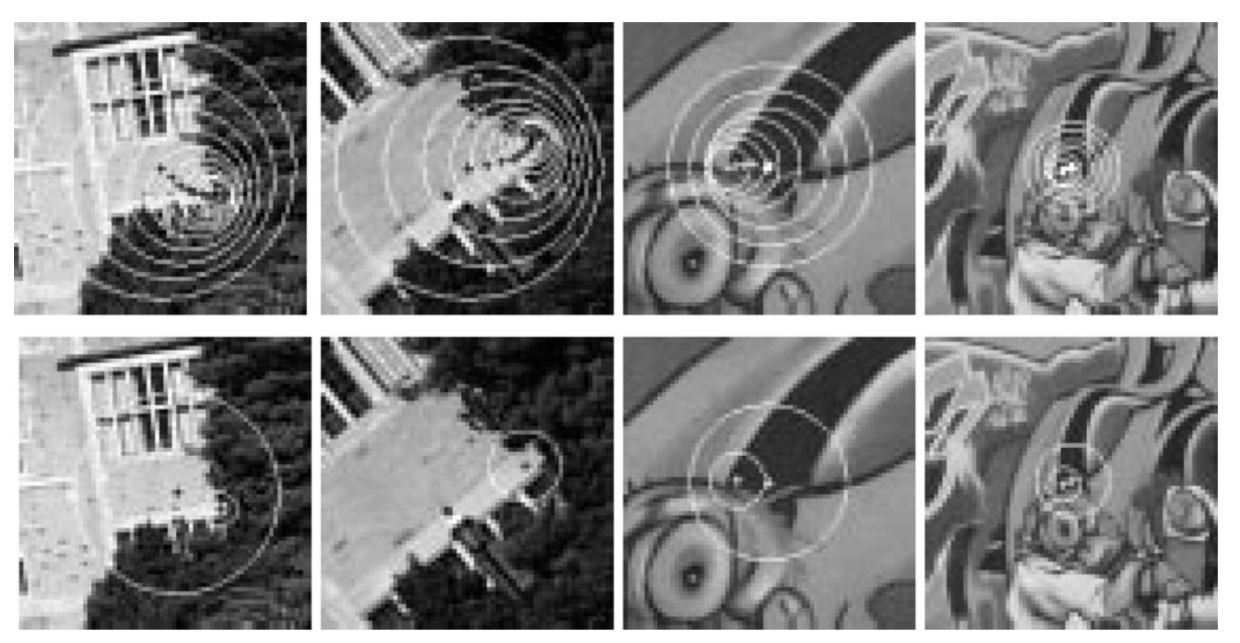
Harris-Laplace Detector
The first one is an iterative algorithm which detects simultaneously the location and the scale of characteristic regions.
The second one is a simplified algorithm, which is less accurate but more efficient.

Slide 7
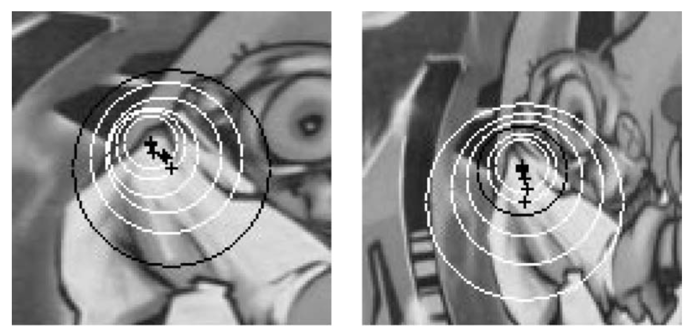
Step1 : a multi-scale point detection

Slide 8
Step1 : a multi-scale point detection

Slide 9
Step2 : LoG response

Slide 10
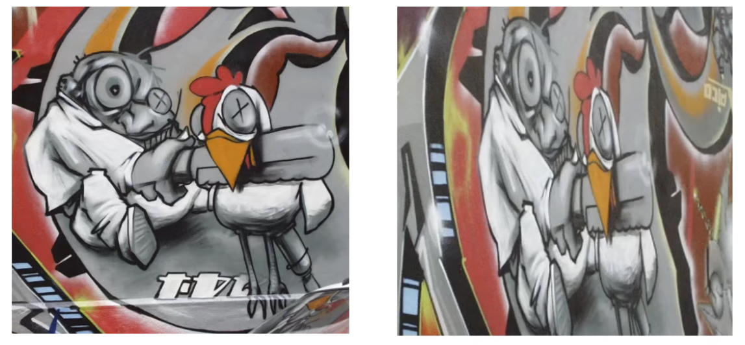
Harris-Affine Detector

Slide 11
Harris-Affine Detector

Slide 12
Harris-Affine Detector

Slide 13
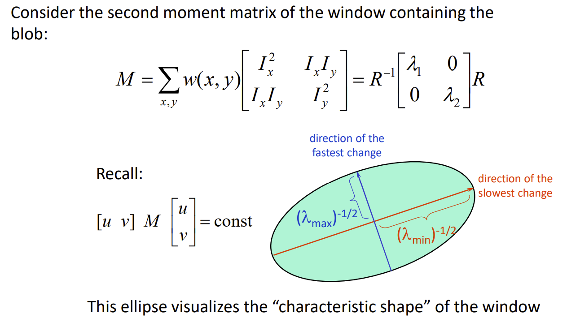
Harris-Affine Detector

Slide 14
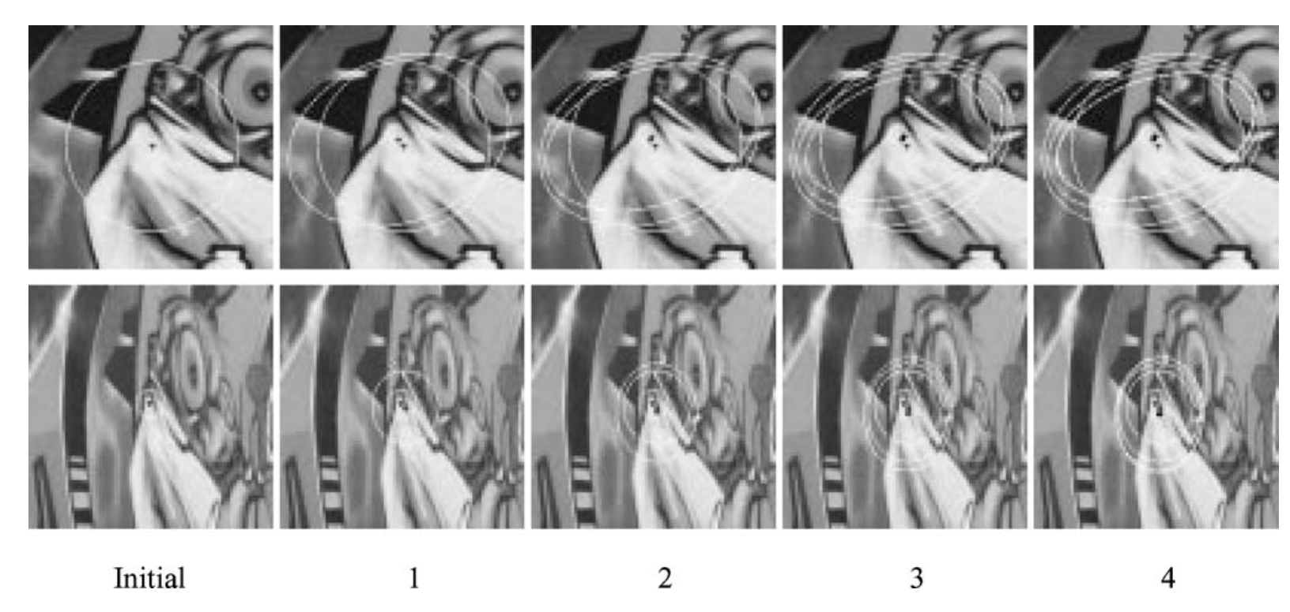
Harris-Affine Detector

Slide 15
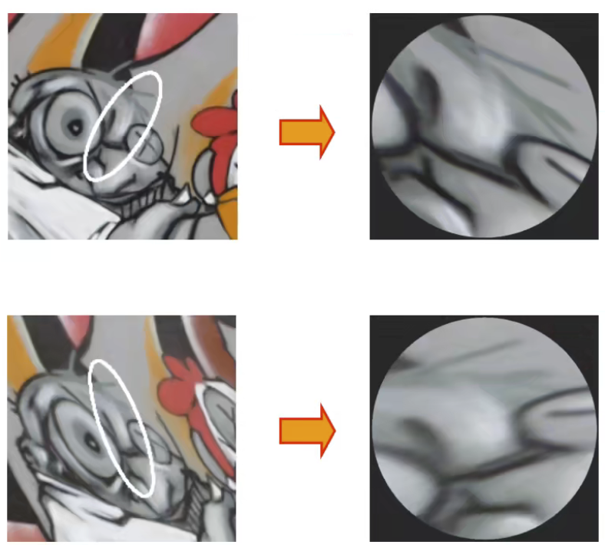
Harris-Affine Detector

Slide 16
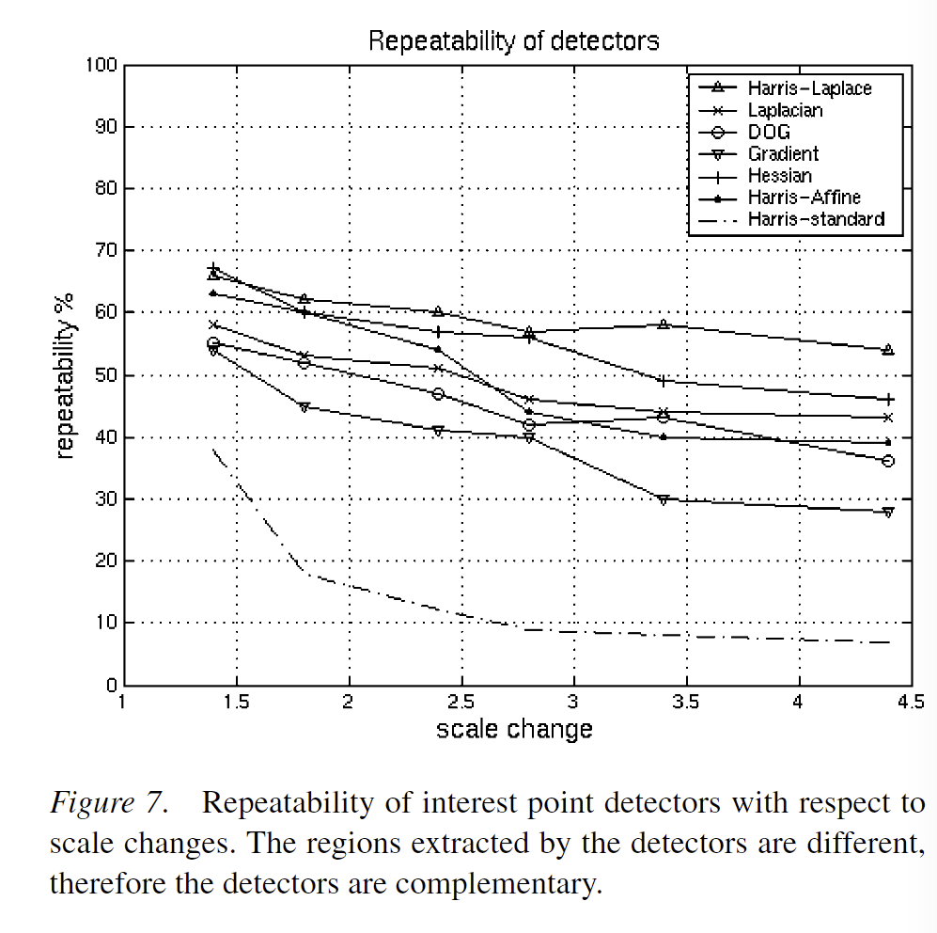
Comparative Evaluation of Interest Points

Slide 17
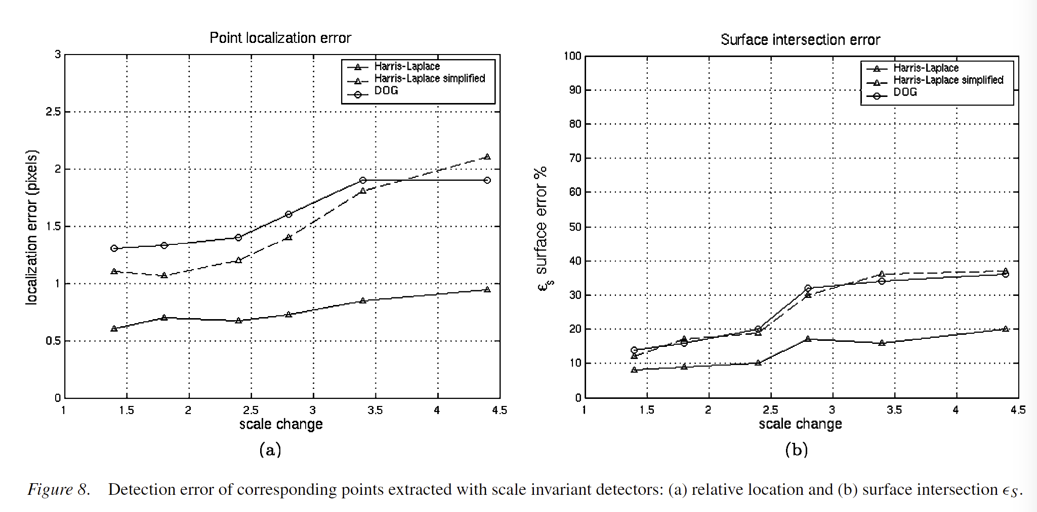
Comparative Evaluation of Interest Points

Slide 18
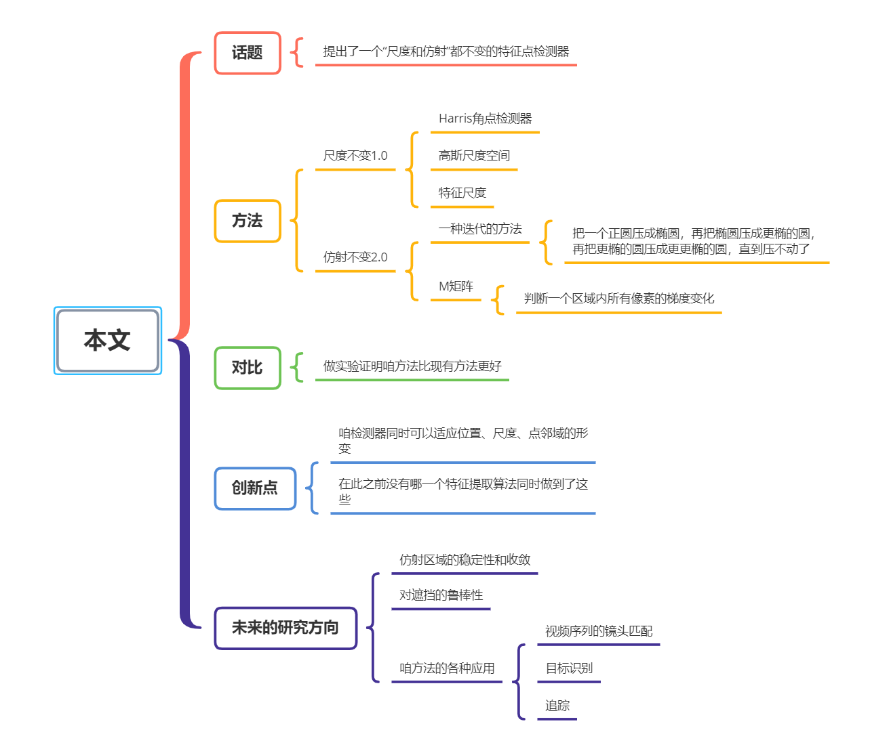

Slide 19
THANKS !

